Slide 1
Health Facility Menu
DEMO

Slide 2
Health Facility Dashboard
DEMO

Slide 3



Mapping Dashboards to Needs
User Group / Persona | Dashboard
CSO Program Officer “I need to understand trends in scores to identify at-risk health centers and exemplary centers.” | Health Facility Dashboard Health Facility Comparison Dashboard Advocacy Dashboard
CSC Facilitator “I need a record of the action plans from each scorecard session to share with the health center and review before the next session.” | Health Facility Dashboard Health Facility Action Plan
PEPFAR Manager “I need data to show how community advocacy actions are influencing health outcomes aligned to PEPFARs goals.” | Health Center Comparison Dashboard Advocacy Dashboard

Slide 4
Health Facility Action Plan
DEMO

Slide 5
Mapping Dashboards to Needs
User Group / Persona | Dashboard
CSO Program Officer “I need to understand trends in scores to identify at-risk health centers and exemplary centers.” | Health Facility Dashboard Health Facility Comparison Dashboard Advocacy Dashboard
CSC Facilitator “I need a record of the action plans from each scorecard session to share with the health center and review before the next session.” | Health Facility Dashboard Health Facility Action Plan
PEPFAR Manager “I need data to show how community advocacy actions are influencing health outcomes aligned to PEPFARs goals.” | Health Center Comparison Dashboard Advocacy Dashboard

Slide 6
Health Facility Comparison Dashboard
DEMO

Slide 7
Mapping Dashboards to Needs
User Group / Persona | Dashboard
CSO Program Officer “I need to understand trends in scores to identify at-risk health centers and exemplary centers.” | Health Facility Dashboard Health Facility Comparison Dashboard Advocacy Dashboard
CSC Facilitator “I need a record of the action plans from each scorecard session to share with the health center and review before the next session.” | Health Facility Dashboard Health Facility Action Plan
PEPFAR Manager “I need data to show how community advocacy actions are influencing health outcomes aligned to PEPFARs goals.” | Health Center Comparison Dashboard Advocacy Dashboard

Slide 8
Advocacy Dashboard
DEMO

Slide 9
Mapping Dashboards to Needs
User Group / Persona | Dashboard
CSO Program Officer “I need to understand trends in scores to identify at-risk health centers and exemplary centers.” | Health Facility Dashboard Health Facility Comparison Dashboard Advocacy Dashboard
CSC Facilitator “I need a record of the action plans from each scorecard session to share with the health center and review before the next session.” | Health Facility Dashboard Health Facility Action Plan
PEPFAR Manager “I need data to show how community advocacy actions are influencing health outcomes aligned to PEPFARs goals.” | Health Center Comparison Dashboard Advocacy Dashboard

Slide 10
A Tour of the Sample Dataset
DATA

Slide 11
Identify Your Data Sources
DATA

Slide 12
Transform Data to a Normalized Table
DATA

Slide 13
Common Data Quality Issues & Ways to Avoid Them
DATA

Slide 14
How to Add New Records and Fields
DATA

Slide 15
How to Edit Existing Records with Forms
DATA

Slide 16
A Tour of the Community Advocacy Dashboard
DASHBOARD

Slide 17
Replacing the Sample Dataset
DASHBOARD

Slide 18
Navigating the Data Pane
DASHBOARD

Slide 19
Joining Indicator Data with Facility Attributes
DASHBOARD

Slide 20
Relationships between Data Sources in Tableau
DASHBOARD

Slide 21
Editing the Indicator Category Group
DASHBOARD

Slide 22
Editing Parameters
DASHBOARD

Slide 23
A parameter will allow you to provide a value to pass into Tableau.
Parameters allow you to come up with scenarios or options that are not available in your data and create these values to put into your visualization. After creation, end users can control the input to see the results of the parameters effect.
How to Create and Use Parameters in Tableau | Interworks
https://interworks.com/blog/interworks/2012/03/26/how-to-create-and-use-parameters-in-tableau

Slide 24
Data Quality Checks
DASHBOARD

Slide 25
Date Formatting: Calendar v. USG Fiscal Year
DASHBOARD

Slide 26
Novel Chart Types: Tadpole Chart
DASHBOARD

Slide 27
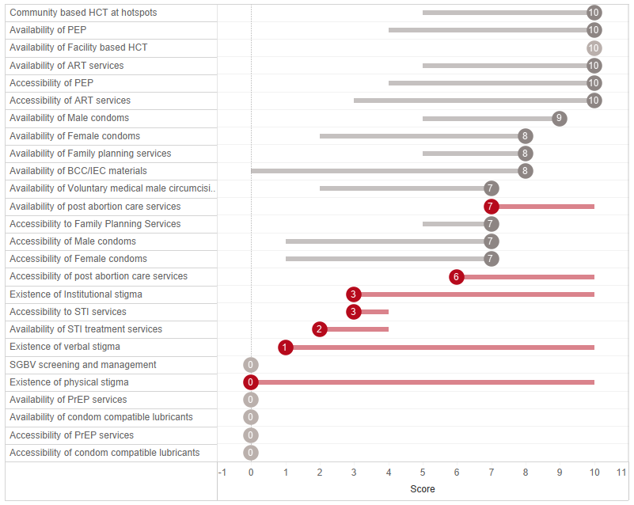
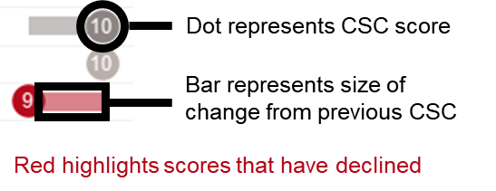

Slide 28
Novel Chart Types: Small Multiples Area Chart
DASHBOARD

Slide 29
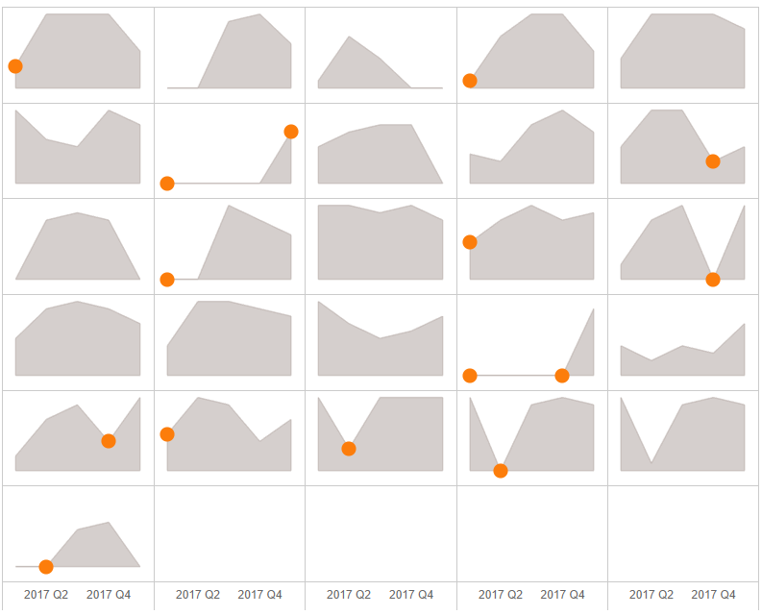
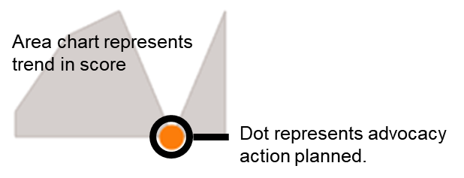

Slide 30
Novel Chart Types: Jitter Plot
DASHBOARD

Slide 31
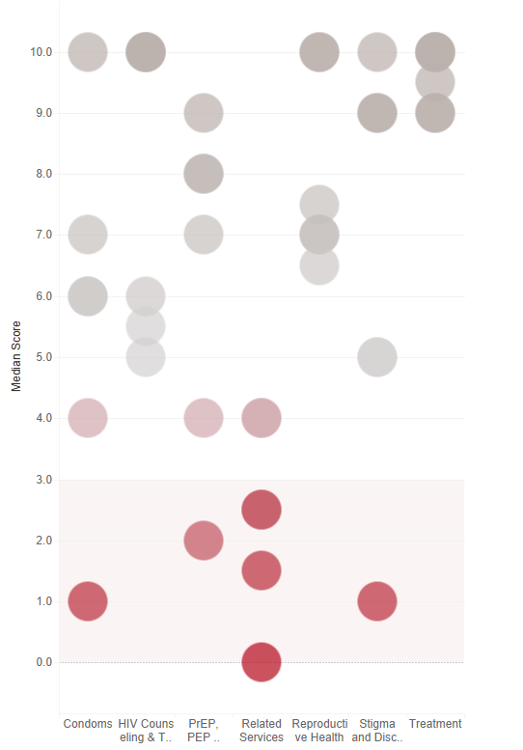

Slide 32
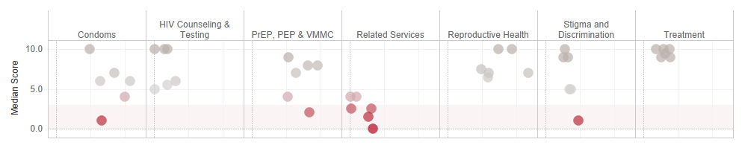

Slide 33
How to Add a New Chart
DASHBOARD

Slide 34
How to Add New Charts to the Health Facility Dashboard Menu
DASHBOARD

Slide 35
How to Add New Charts on a Dashboard
DASHBOARD

Slide 36
How to Edit Tooltips
DASHBOARD

Slide 37
Common Errors to Watch For
DASHBOARD

Slide 38
Printing a PDF Report from the Dashboard
DASHBOARD

Slide 39
Exporting a Packaged Workbook to Share
DASHBOARD

Slide 40
Export Views to Powerpoint
DASHBOARD

